Slide 1
Chemical Changes
February 2017

Slide 2
Review from Grade 9: Physical Property
Is a description of a substance that can be used to identify it.
List as many examples of physical properties as you can.

Slide 3
Chemical Change:
Is a change in which a substance (the ____________) turns into a new substance (the _____________)
the new substance (the product) does not have the same properties (i.e. doesn’t _______ the same, doesn’t ________ the same) as the original substance (the reactant)
Chemical changes are also called __________ ___________.

Slide 4
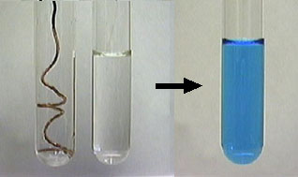
How do we know that a chemical reaction has taken place?
1) There might be a change in ______________.

Slide 5
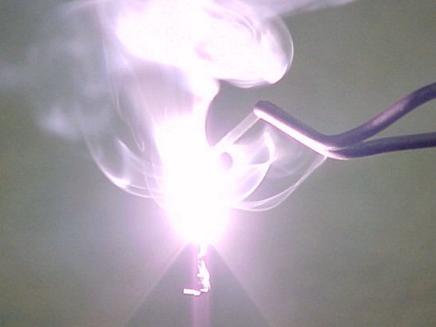
How do we know that a chemical reaction has taken place?
2) _________ might be produced.

Slide 6
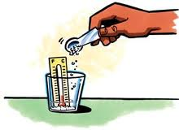
How do we know that a chemical reaction has taken place?
3) The substance might get _________ or __________ (without heating or cooling the substance).

Slide 7
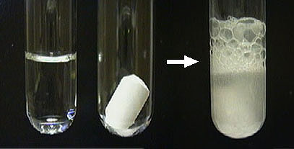
How do we know that a chemical reaction has taken place?
4) ________ ___________ might form.

Slide 8
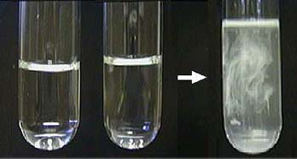
How do we know that a chemical reaction has taken place?
5) A solid material, called a _______________, might form when 2 liquids are mixed.

Slide 9
Representing Chemical Reactions
The starting materials are called ___________________.
What the reactants turn into are called _________________________.
Chemical reactions are sometime represented by ___________ ________________.
If there is more than 1 reactant or product, they are separated by + signs.
The reactants and products are separated by an ____________________.
The arrow is read as “_____________________” or “__________________”.

Slide 10
Examples of word equations:
Hydrogen + Oxygen → water
Methane + oxygen → carbon dioxide + water

Slide 11
Practice:
Write word equations for the following descriptions by first underlining the reactants and circling the products in each.
1) Aluminum metal combines with chlorine gas to make aluminum chloride.
2) Magnesium metal combines with nitrogen gas to produce magnesium nitride.
3) Calcium chloride and sodium sulfide solutions are mixed. A precipitate of calcium sulfide and sodium chloride solution is made.

